Slide 1
FAFSA Submission Summary

Slide 2
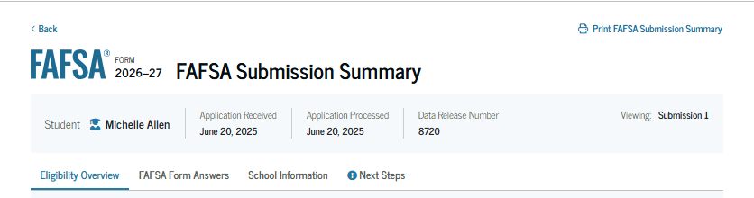
FAFSA Submission Summary Landing Page
The student receives a FAFSA Submission Summary for their processed FAFSA® form and any subsequent corrections that the student submits. The FAFSA Submission Summary is divided into four tabs: "Eligibility Overview," "FAFSA Form Answers," "School Information," and "Next Steps." At the top, the student will see when the FAFSA form was received and processed. The student also has the option to print the FAFSA Submission Summary to keep for their records.

Slide 3
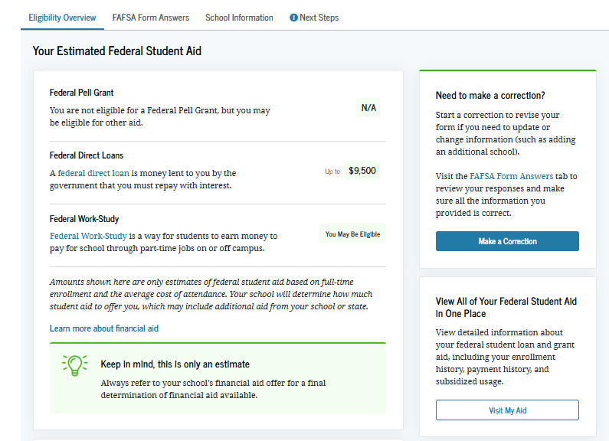
Eligibility Overview
On the "Eligibility Overview" tab, the student sees information about the federal student aid for which they may be eligible, such as a Federal Pell Grant and Federal Direct Loans. Any amounts of financial aid that display on this tab are estimates and are not guaranteed. The school's financial aid office provides final determination of the student’s financial aid eligibility.

Slide 4
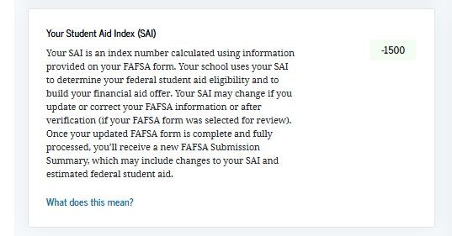
Eligibility Overview (Continued)
This is a continuation of the "Eligibility Overview" tab of the FAFSA Submission Summary. The student can view their Student Aid Index. The school's financial aid office provides final determination of the student’s financial aid eligibility.

Slide 5
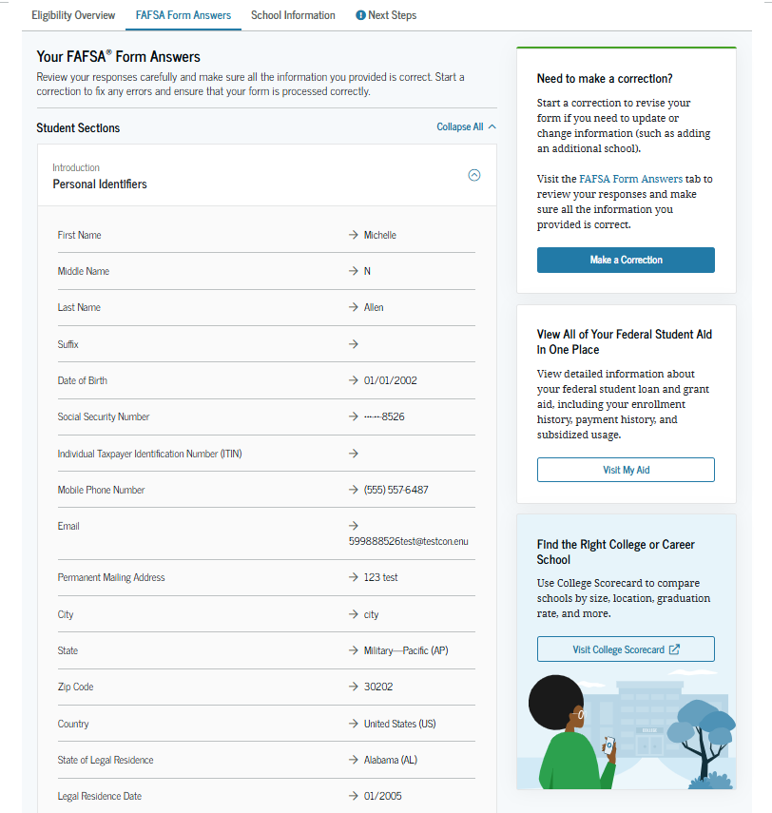
FAFSA® Form Answers
On the "FAFSA Form Answers" tab, the student sees the answers provided on their FAFSA® form. If any of the provided answers are incorrect, the student can choose "Make a Correction."

Slide 6
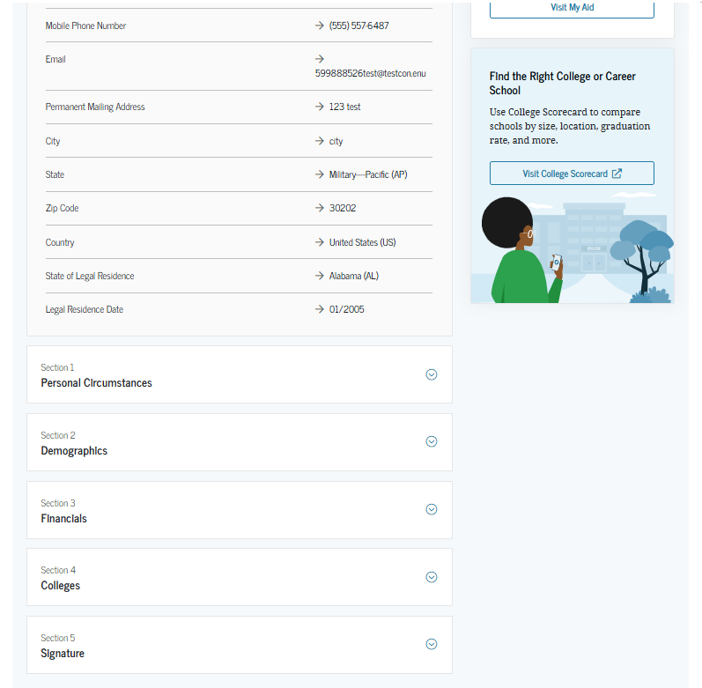
FAFSA® Form Answers (Continued)
This is a continuation of the "FAFSA Form Answers" tab, where the student sees the answers provided on their FAFSA® form.

Slide 7
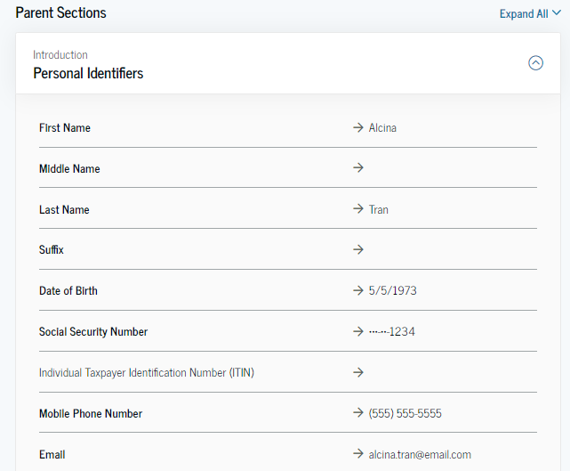
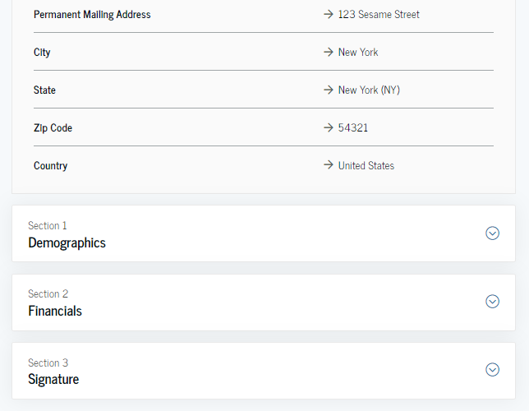
FAFSA® Form Answers Contributors
This is a continuation of the "FAFSA Form Answers" tab. If applicable, the student sees the answers their contributor(s) provided on the FAFSA® form.

Slide 8
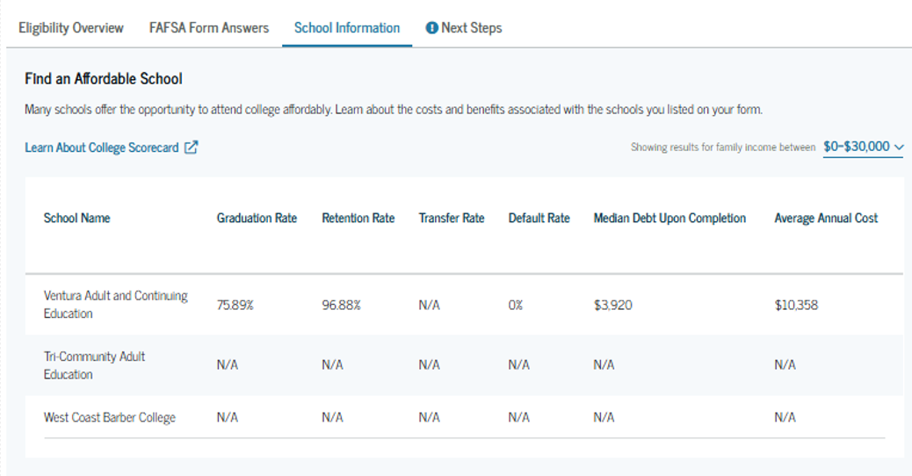
School Information
On the "School Information" tab, the student sees information about the college(s), career school(s), and/or trade school(s) they selected to receive their FAFSA® information. The student can view graduation rate, retention rate, transfer rate, default rate, median debt upon completion, and average annual cost of the selected school(s).

Slide 9
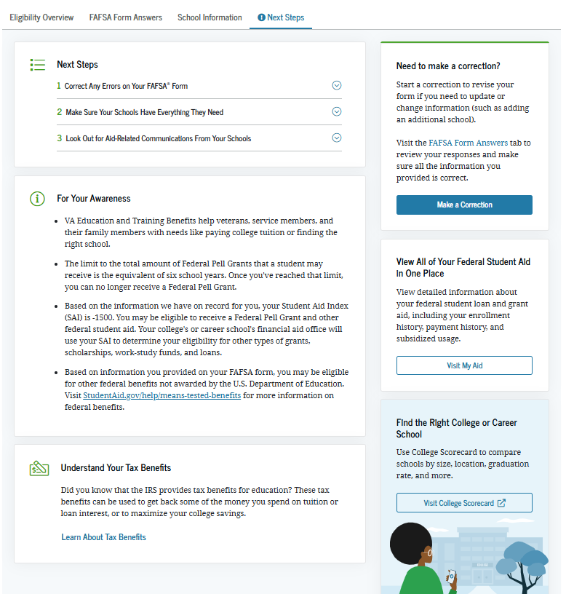
Next Steps
On the "Next Steps" tab, the student sees comments that pertain to their FAFSA® form. Some comments may require the student to make a correction or send additional documentation to their school. Other comments may be informational and require no action from the student.

Slide 10
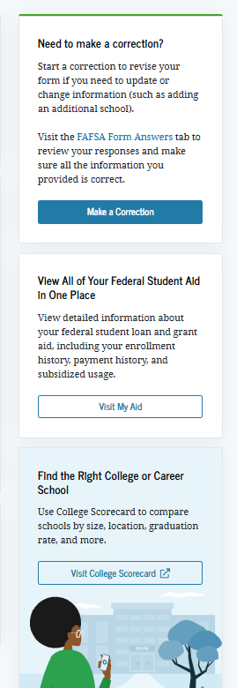
More Resources
Lastly, along the right side of the FAFSA Submission Summary, the student can access additional resources, including links to "My Aid" or College Scorecard.

